Slide 1


Informatica Data Quality Duplicate Record Management

Slide 3
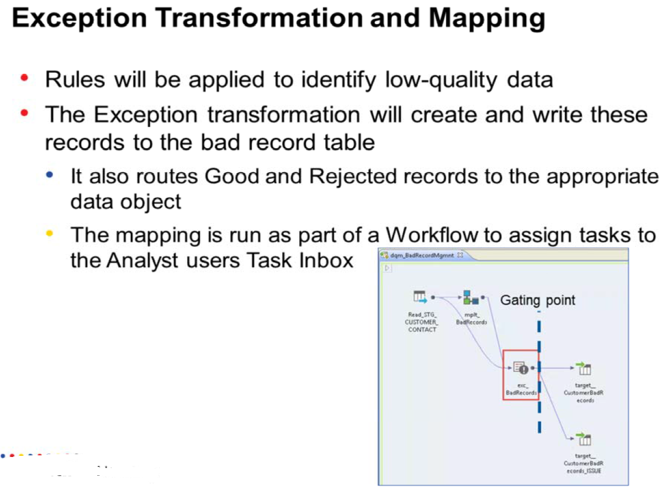

Slide 6
Task 1 : IDQ Duplicate Record Exception

Slide 7
Task 1A : Copy Existing Match Duplicate Mapping ➔ Rename as Match Dup Exception

Slide 8
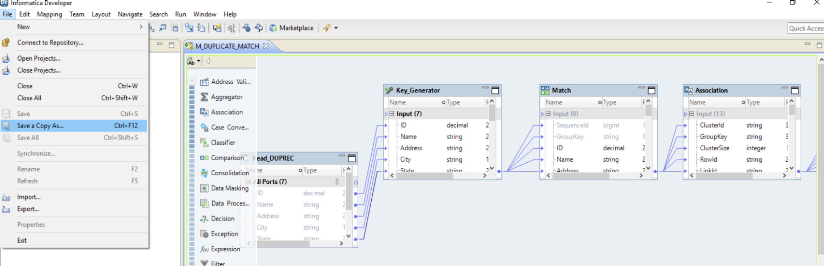
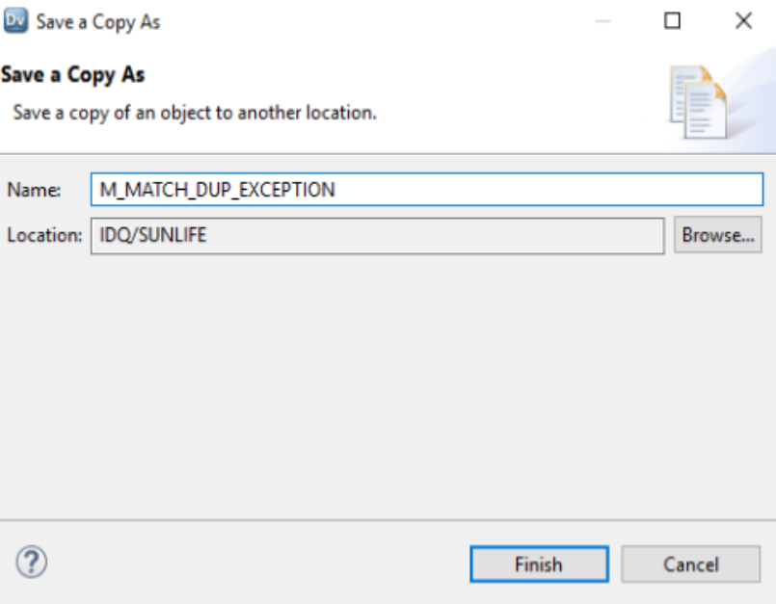
Step 1 : Open Existing Match Duprec Mapping ➔ File ➔ save copy as ➔ Match Dup Exception

Slide 9
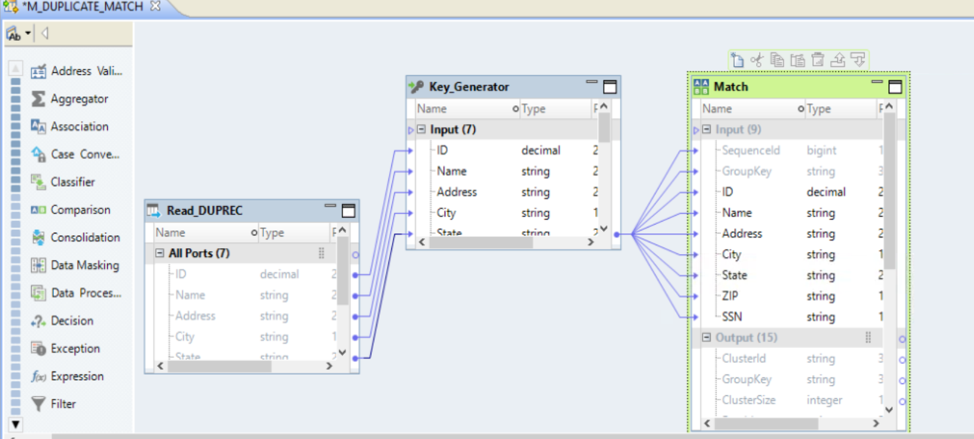
Step 2 : Delete Association , Consolidation , Filter and Target Transformation from the Existing Mapping

Slide 10
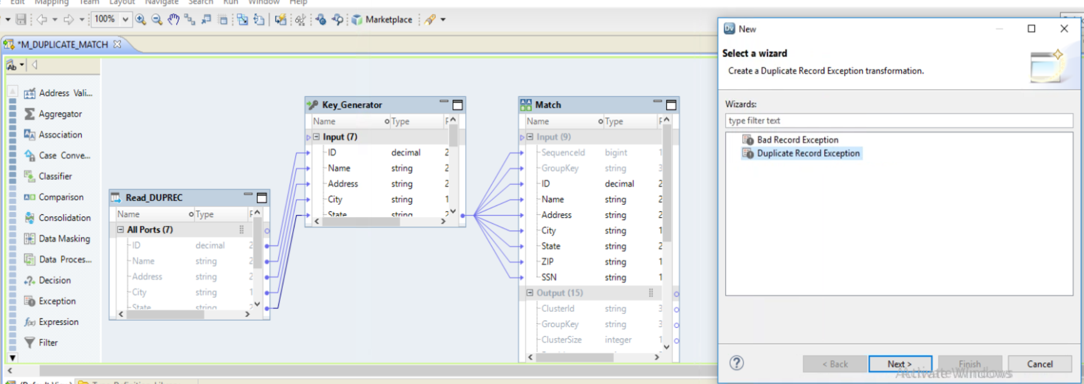
Step 3 : Add New Transformation Exception ➔ Duplicate Record Exception

Slide 11
Task 2 : Add New Transformation Exception ➔ Duplicate Record Exception

Slide 12
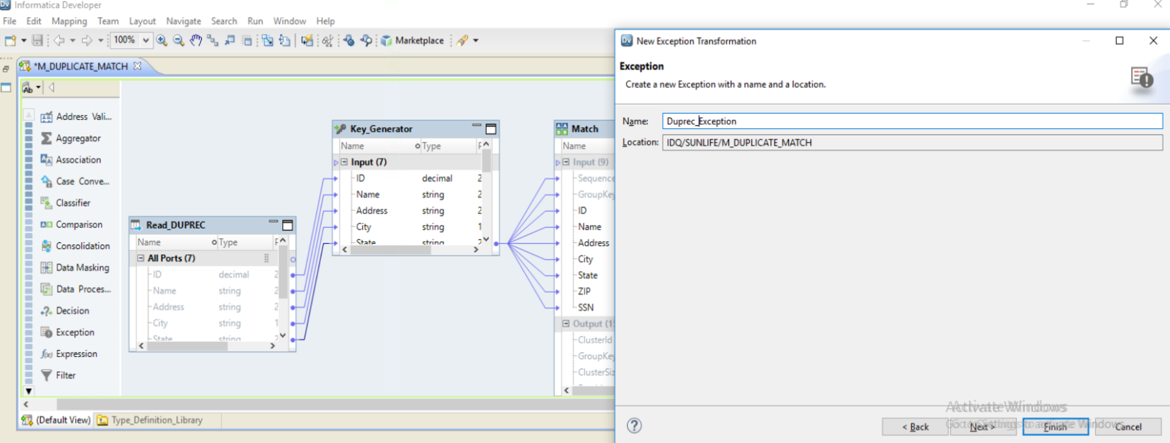
Step 4 : Name the ExceptionTransformation

Slide 13
Task 3 : Configure Exception Transformation Exception ➔ with THreshold

Slide 14
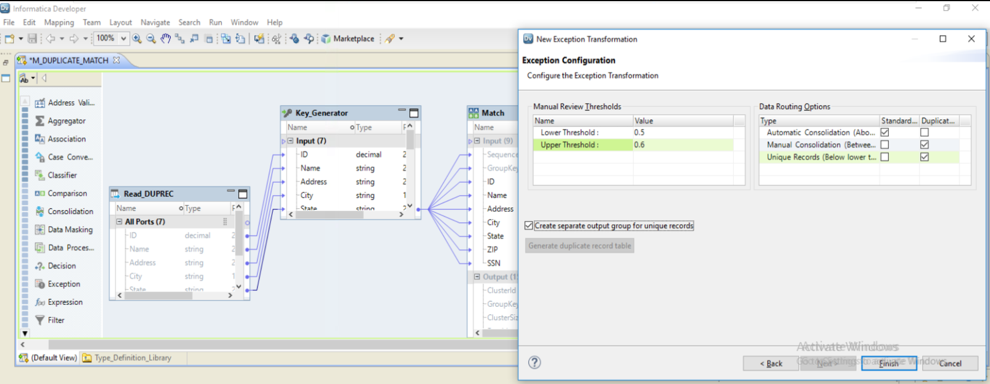
Step : Configure Threshold

Slide 15
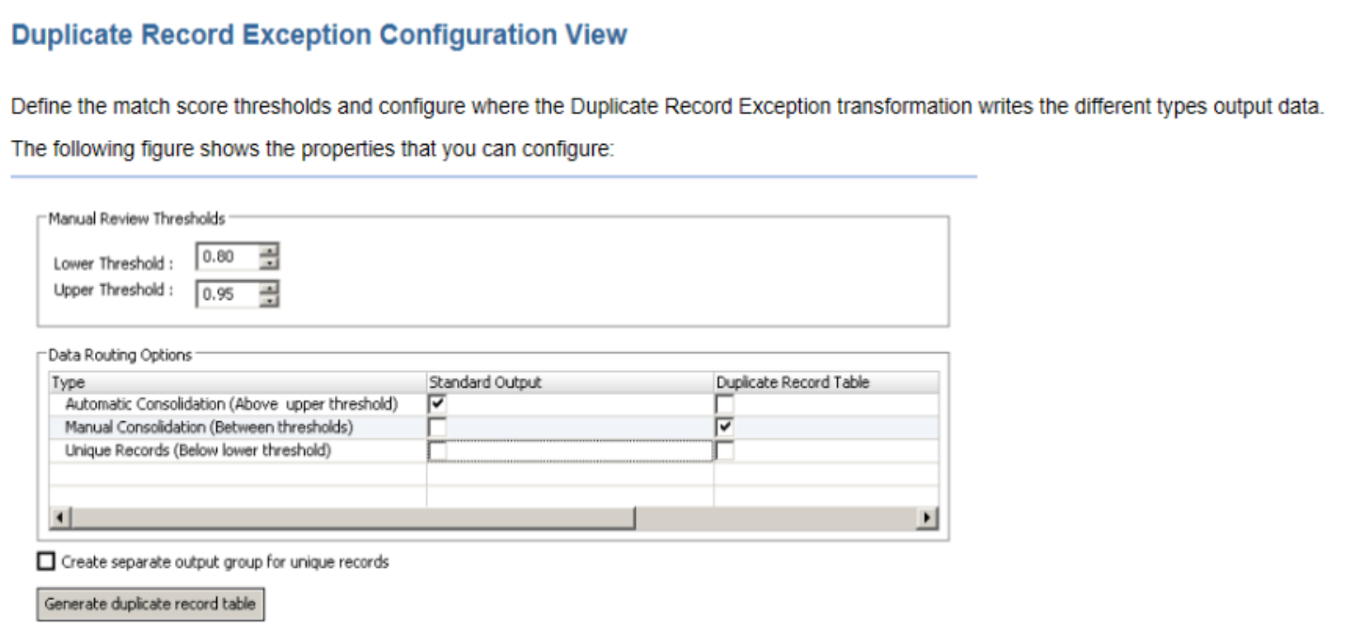
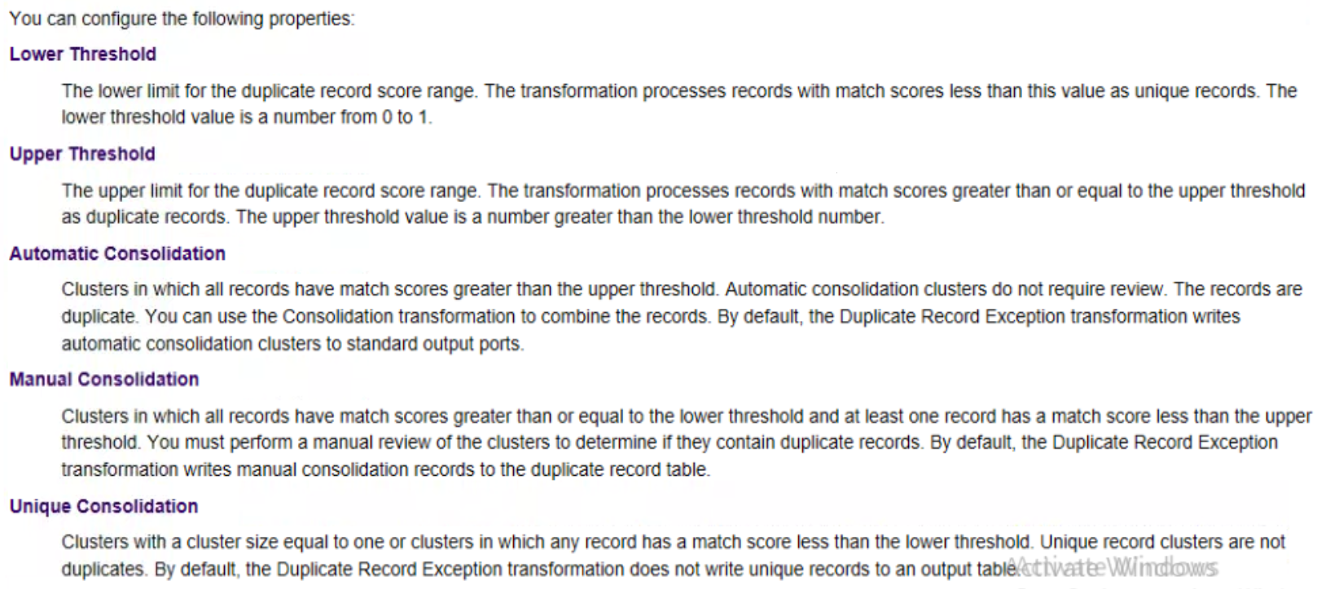

Slide 16
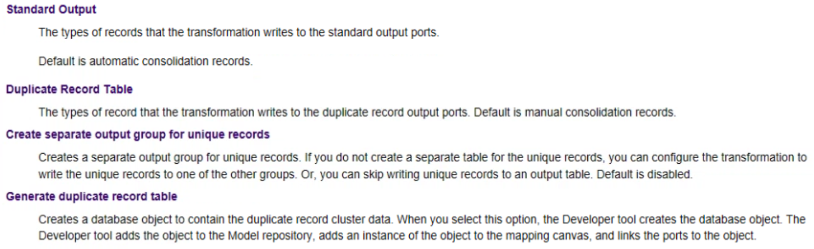

Slide 17
Task 4 : Map Exception Transformation ➔ Control Group

Slide 18
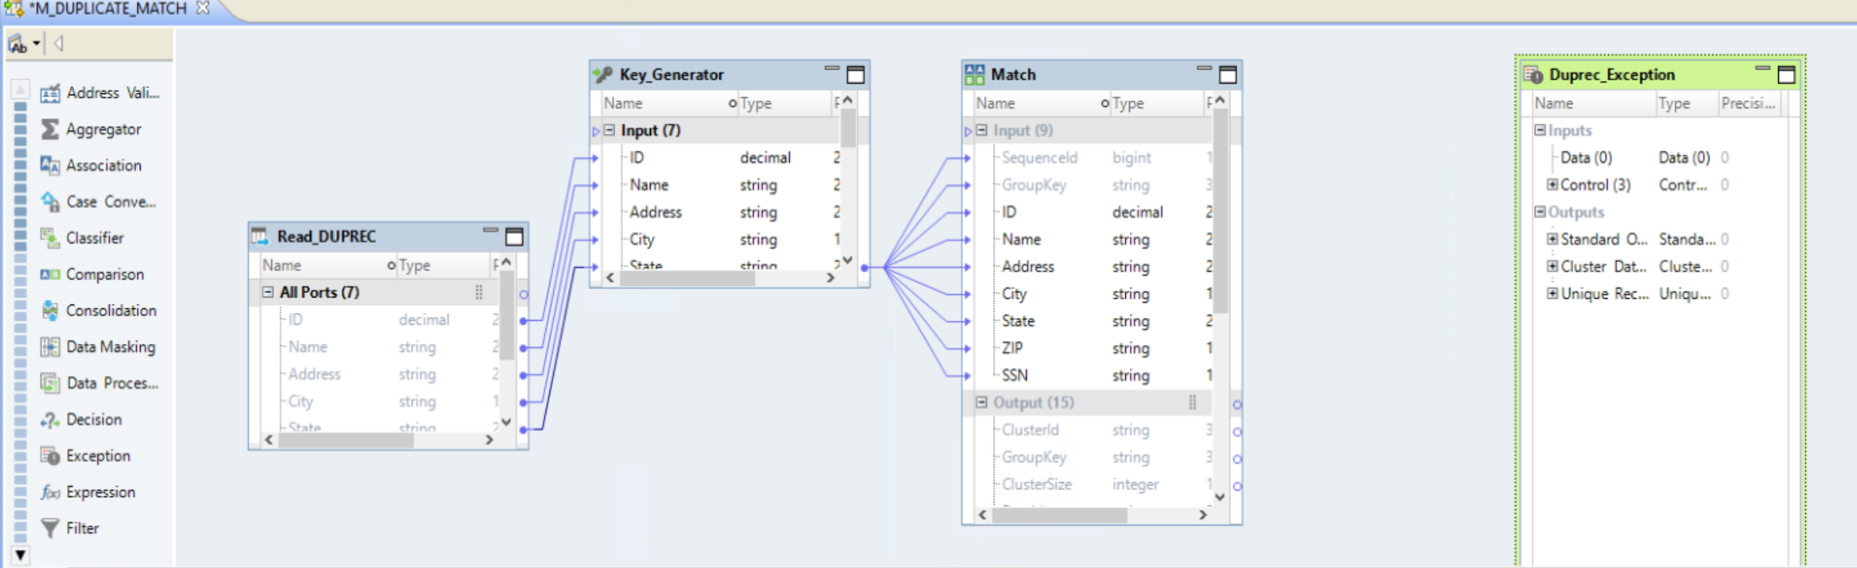

Slide 19
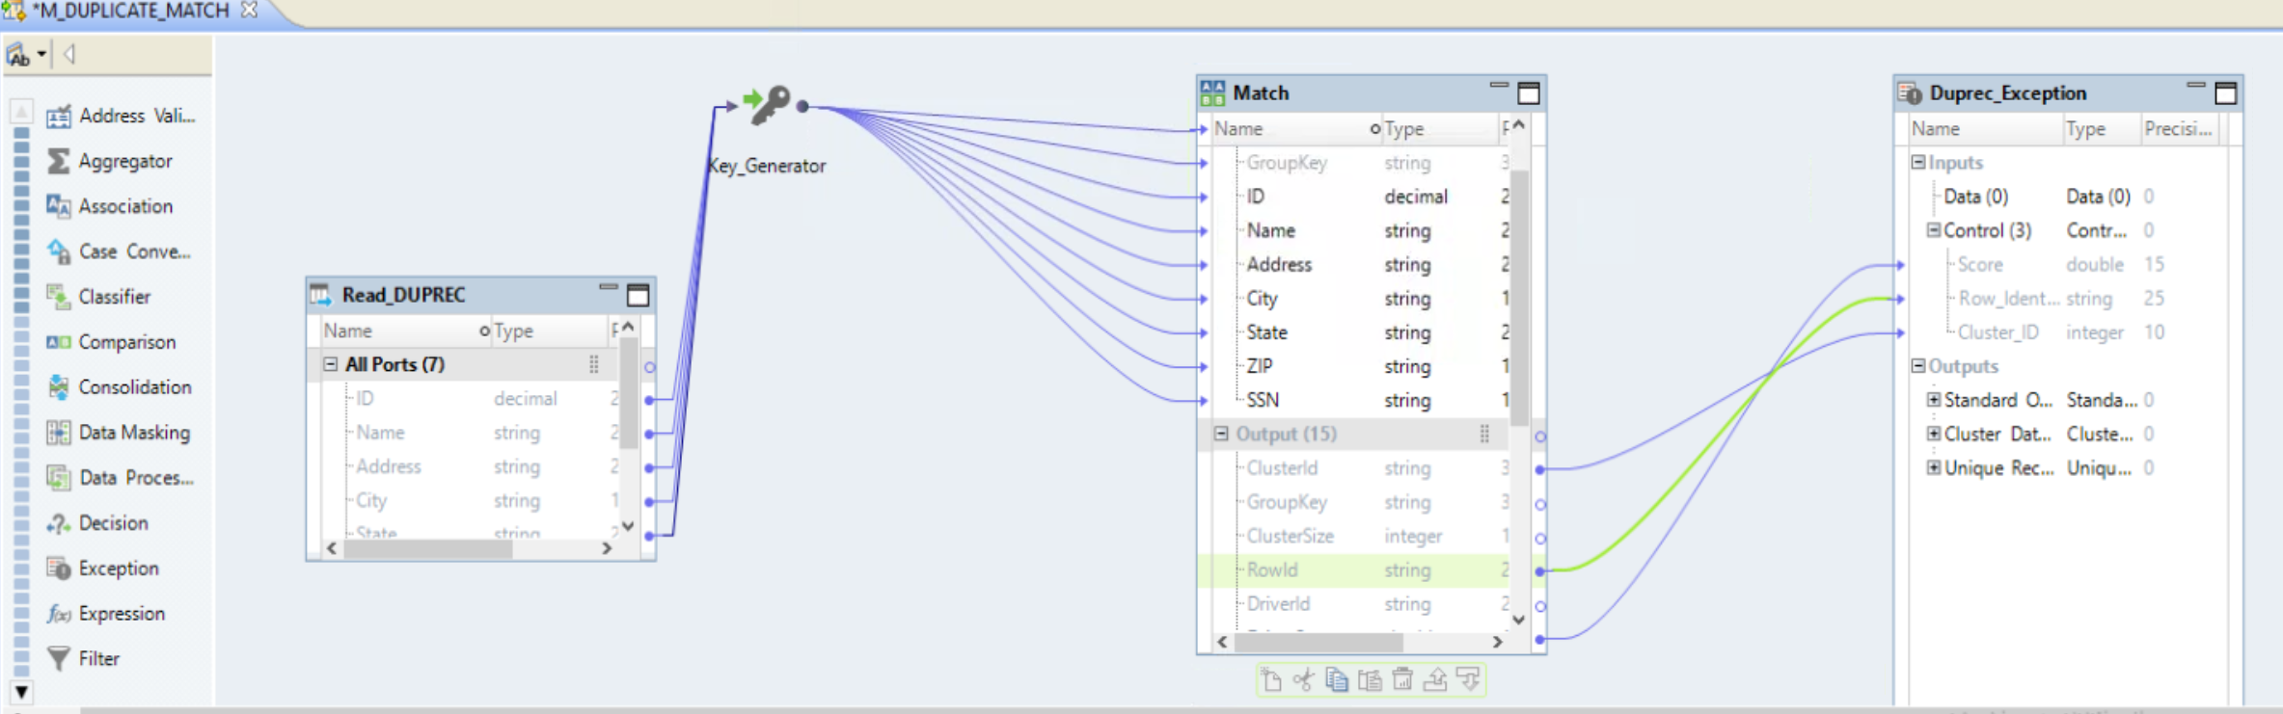
Step : Map Exception transformation ➔ Control Group s

Slide 20
Task 4 : Map Exception Transformation ➔ Data Group

Slide 21
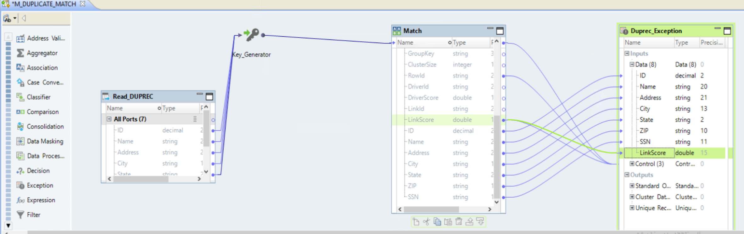

Slide 22
Task 5 : Run DATA Viewer on Exception Transformation

Slide 23
